Slide 1
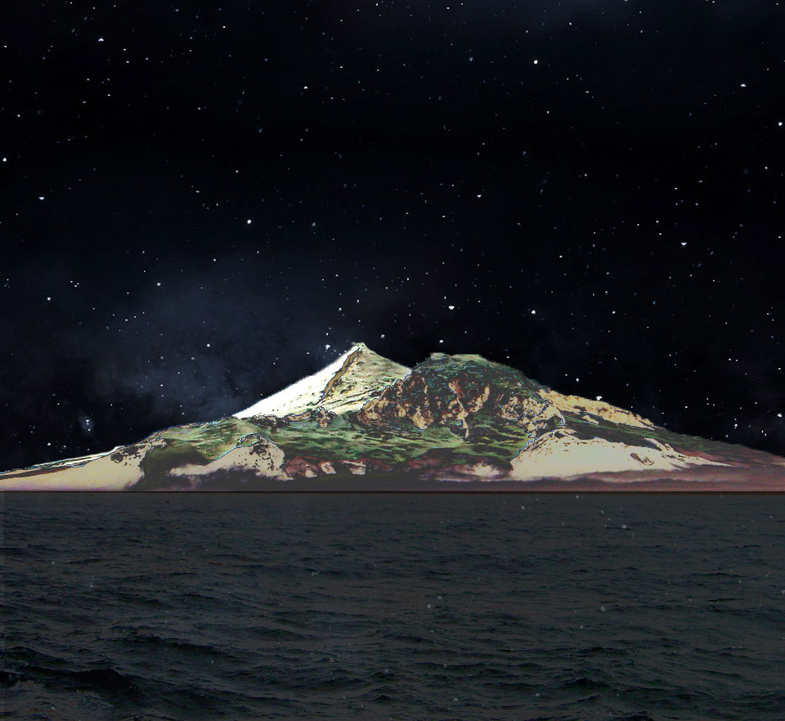
VKØEK
Heard Island 2016
Cordell Expeditions

Slide 2
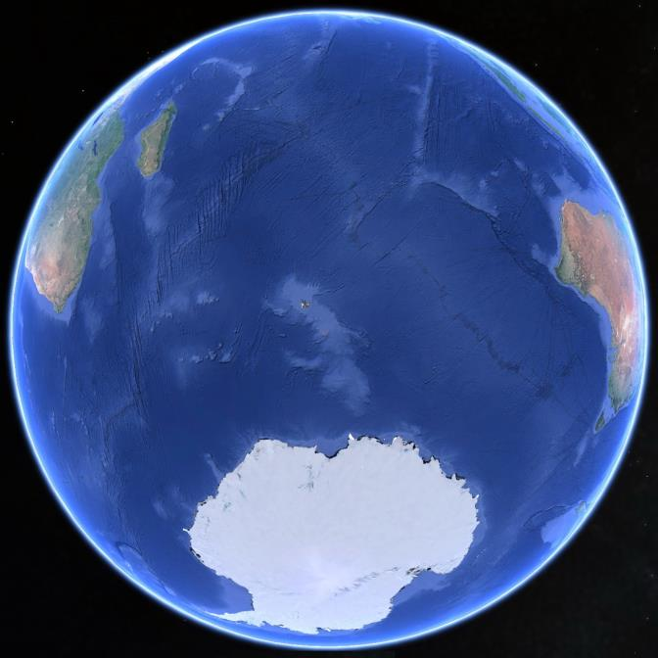
Heard Island
Notes:
Heard Island is located at 53°S 73°E, about 1000 miles from Antarctica

Slide 3
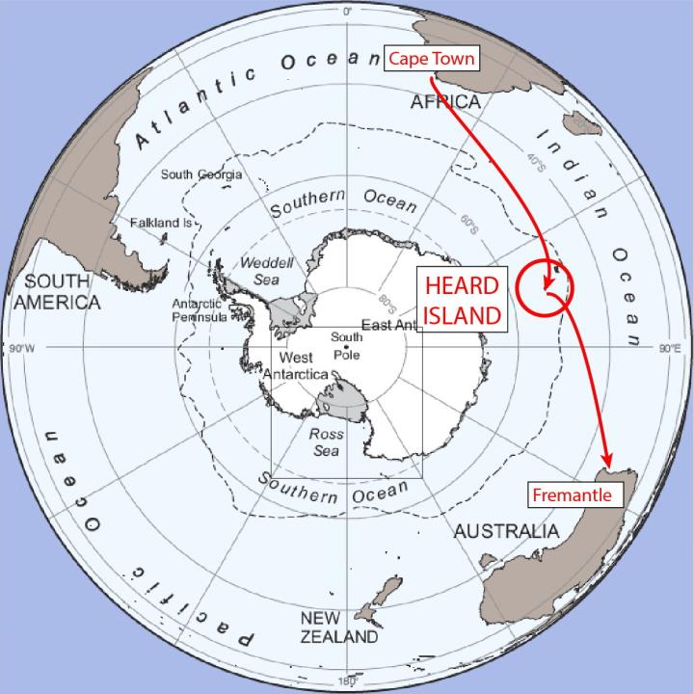
Notes:
The 2016 Expedition will start in Cape Town, South Africa, on or around March 10, 2016, spend nominally 3 weeks at Heard Island, and continue to Fremantle, Australia, arriving on or around April 22, 2016.

Slide 4
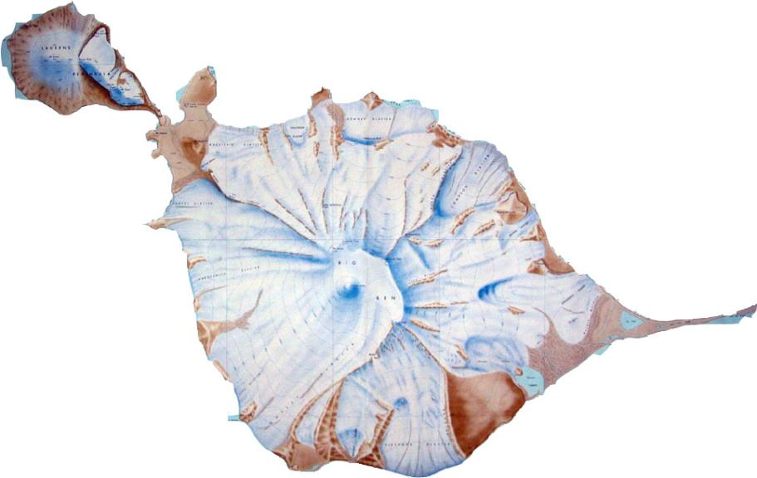
Atlas Cove
Spit Bay
Long Beach
Notes:
Heard Island is covered with glaciers that slide down the slopes of the mountain. The volcano erupts every few years, most recently in mid-2015. The three main visitor areas are noted.

Slide 5
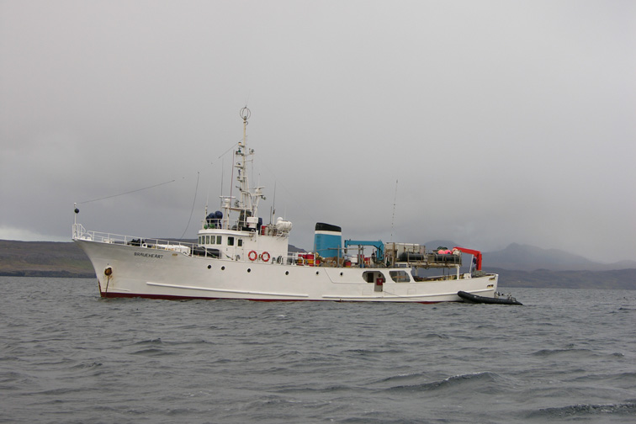
Notes:
The expedition vessel is the Braveheart, operated by Nigel Jolly (New Zealand). It has taken a dozen previous DXpeditions on southern expeditions, and many tourist voyages.

Slide 6
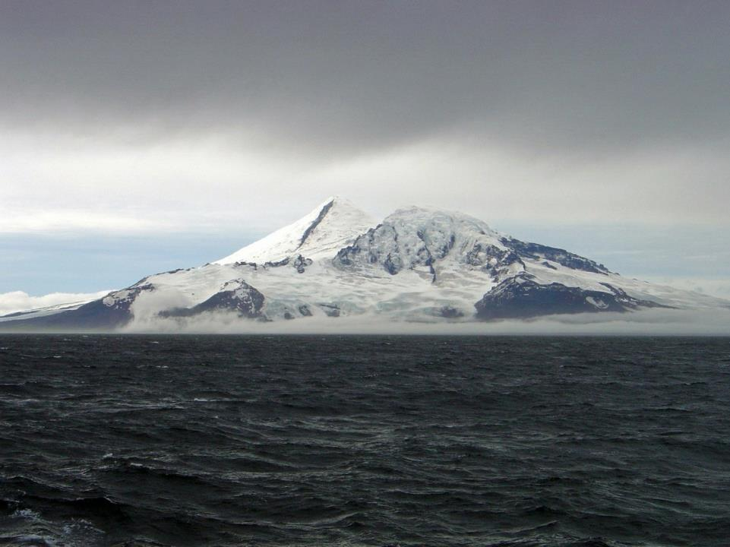
Notes:
Heard Island is dominated by Mawson Peak on the top of Big Ben, 9000 ft. high. The island is about 20 miles across, tip-to-tip.

Slide 7
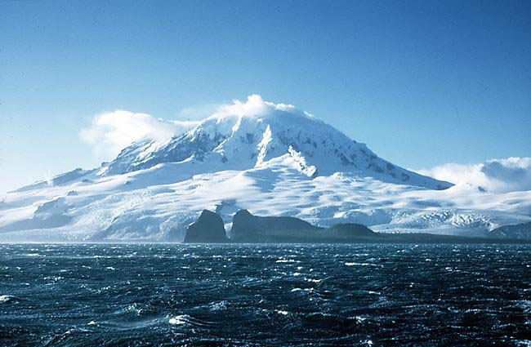
Notes:
Clear days on Heard Island are rare. The temperature is normally a few degrees above freezing, and normally the island is shrouded in rain and fog. This was a rare, clear day.

Slide 8
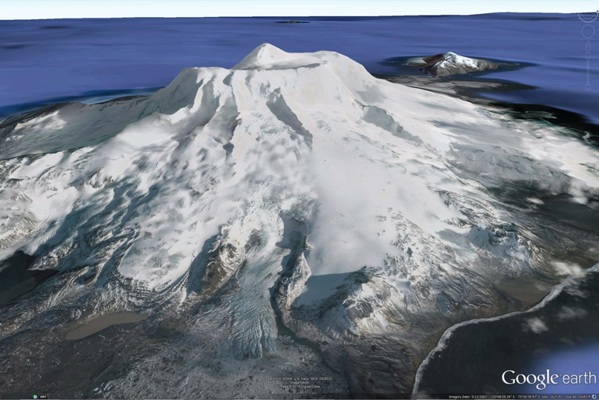
Notes:
Big Ben is a huge volcano, with numerous glaciers that slide down the upper slopes. Some glaciers drop directly in the ocean, while others terminate on land. Most glaciers are retreating (melting) at high rates due to global warming, some up to 100 m/yr.

Slide 9
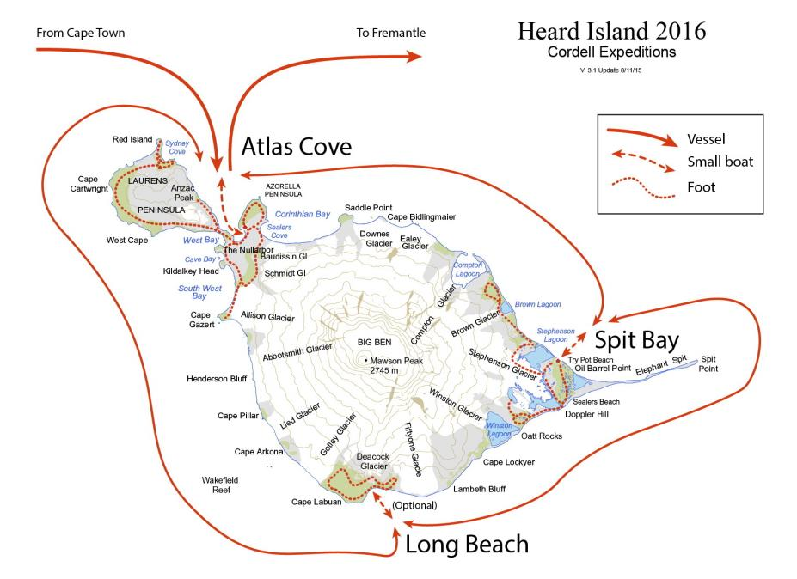
Notes:
The 2016 expedition will establish the main camp and radio operation at Atlas Cove, and a secondary radio operation at Spit Bay. As time permits, visits will be made to Long Beach and other areas as part of the scientific research, which aims at obtaining new information related to global climate change.

Slide 10
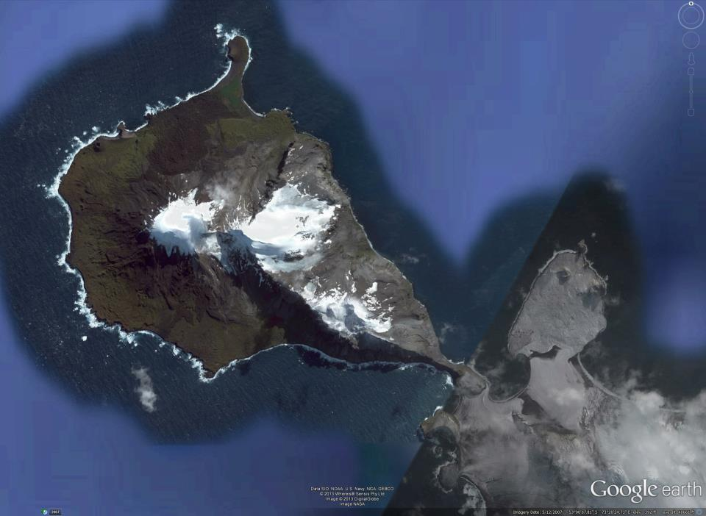
Laurens Peninsula
Atlas Cove
VKØEK
Campsite
Notes:
To the west of Atlas Cove is the Laurens Peninsula, a prime target for research on the geology and biology of Heard Island. Exploration of this area will be done on foot, as short forays from the main camp.

Slide 11
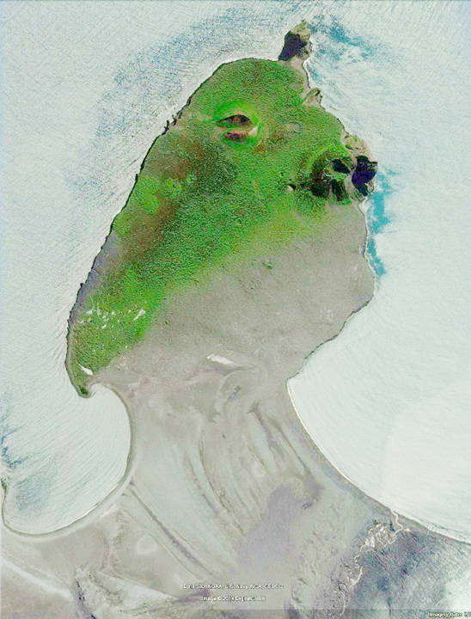
*
Notes:
The Azorella Peninsula provides protection for a variety of seals, seabirds, and an incompletely described insect and microfauna. The VKØEK campsite will be approximately at the red mark. The peninsula is normally is off-limits to visitors.

Slide 12
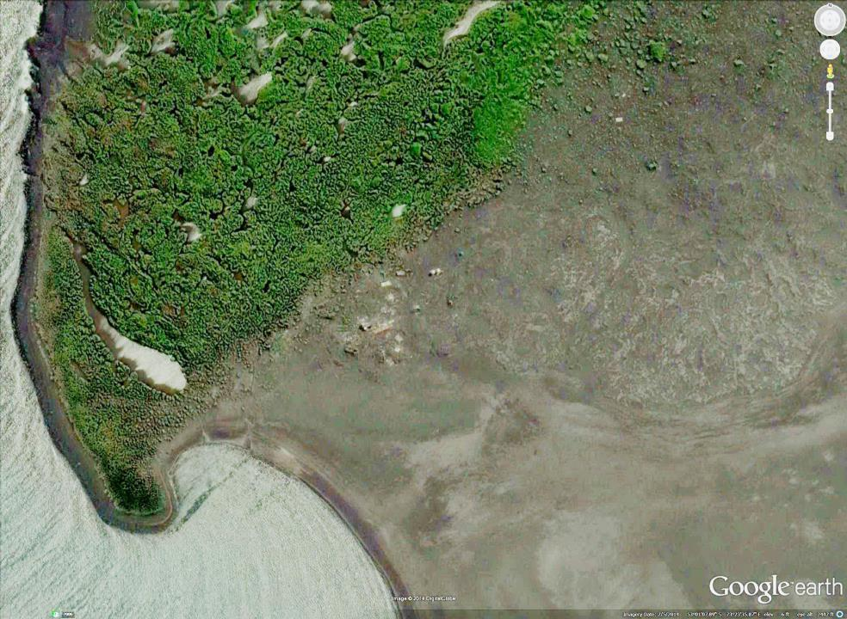
VKØEK
*
Notes:
Ruins of the 1947 Australian research camp (ANARE) can still be seen near the safe beach landing in the hook of the Cove. Two white dots in this image just to the NW of these ruins are shelters installed by the Australian government. The 2016 VKØEK DXpedition will establish the main camp close to these shelters, at or near the red mark.

Slide 13
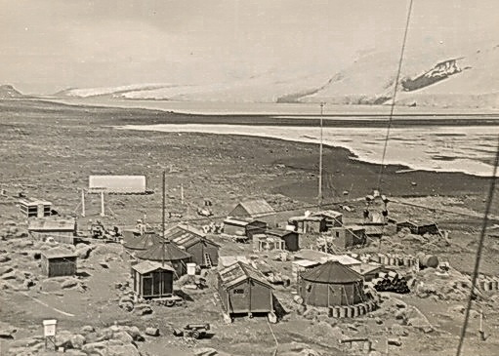
1947
ANARE 1947
Notes:
A general view of the 1947 ANARE campsite, now totally in ruins and mostly blown away by the incessant high winds.

Slide 14
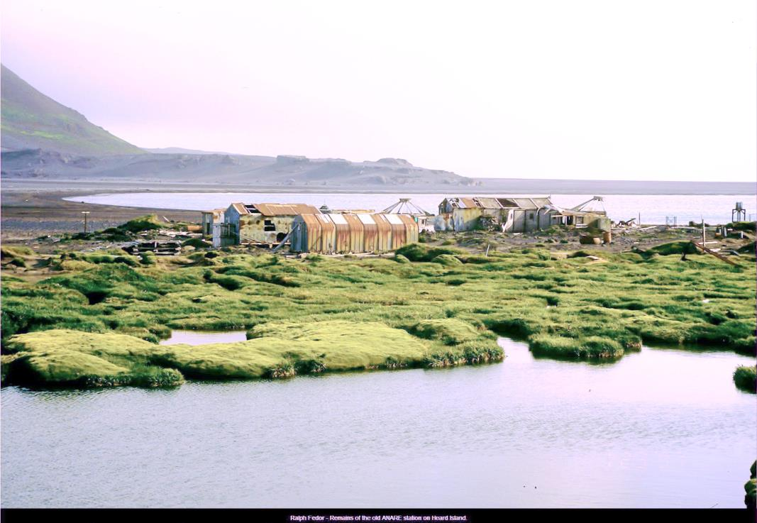
1997
ANARE 1997
Notes:
Another view of the ANARE ruins in 1997. Again, almost all of these buildings are now destroyed.

Slide 15
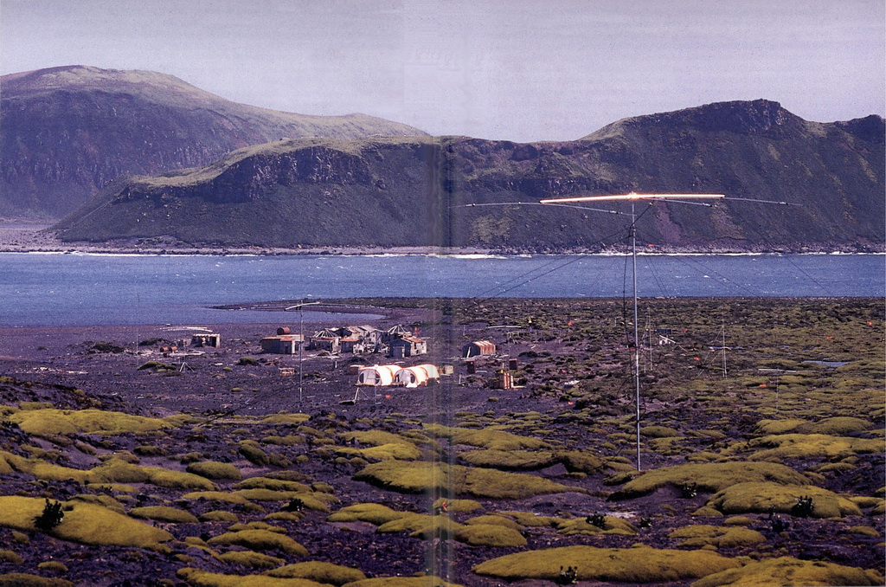
VKØIR 1997
Notes:
View of the 1997 DXpedition VKØIR, with the ANARE ruins lying behind the expedition campsite. The radio antennas in the foreground are attached to a secondary campsite up the slope to the east of the main camp.

Slide 16
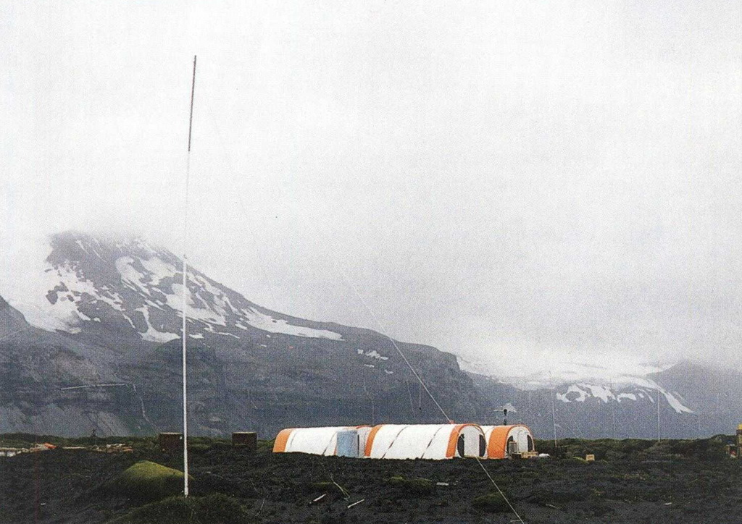
VKØIR 1997
VKØIR 1997
Notes:
The 1997 expedition made use of commonly-used tents made by Weatherhaven. Two of the tents were for sleeping, one was for communications and radio operations, and one was the GEM (Greeting Eating Meeting) tent.

Slide 17
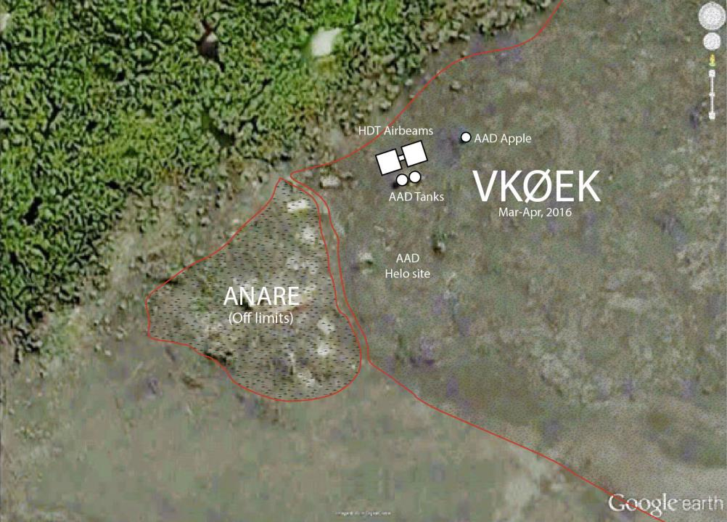
Notes:
Location of the main 2016 VKØEK campsite at Atlas Cove. The ANARE ruins are considered off-limits.

Slide 18
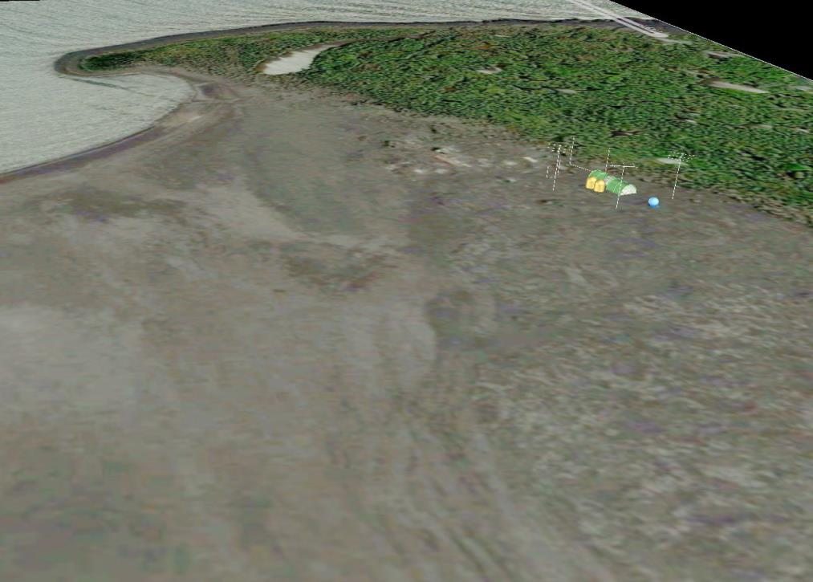
Notes:
A conceptual rendering of an aerial view of the VKØEK campsite, looking to the NW.

Slide 19
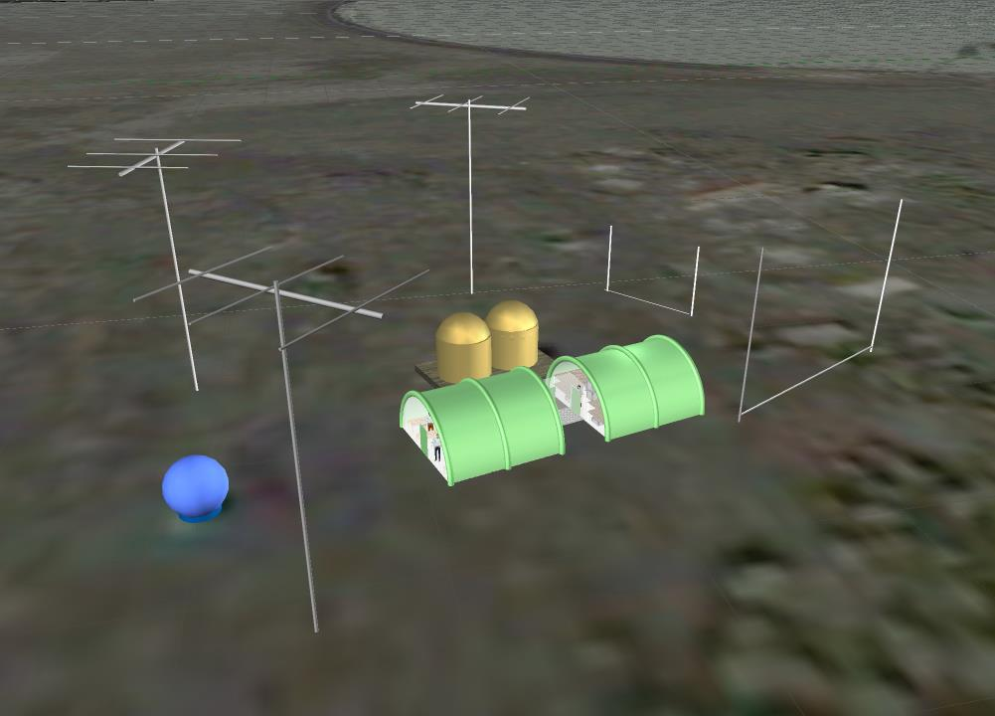
Notes:
A conceptual rendering of the main camp at Atlas Cove. The two green shelters are the expedition tents, made by HDT Global. The gold shelters and the blue sphere are refuges installed by the Australian Antarctic Division, to be used only in case of emergency. The antenna layout is purely symbolic–the actual design is based mostly on vertical four-square arrays.

Slide 20
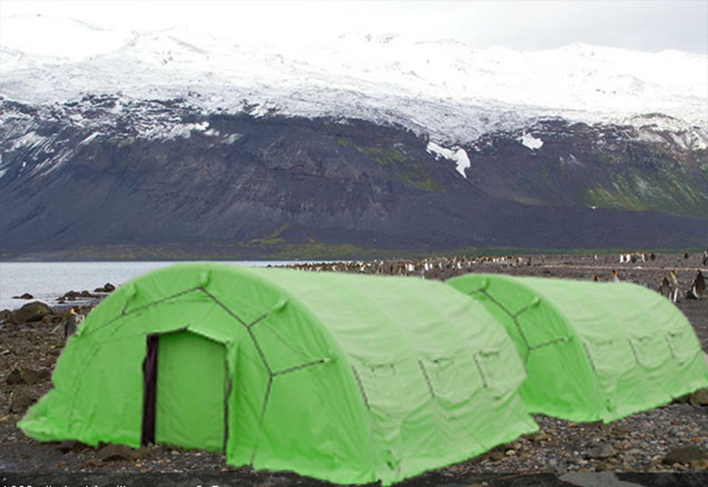
Notes:
Simulation of the main shelters at Atlas Cove, with the Laurens Peninsula in the background.

Slide 21
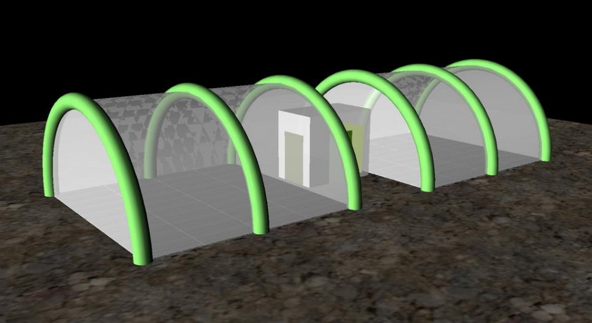
Notes:
The Airbeam shelters are inflated by an air compressor in about 15 minutes (each). They are connected by a protected passageway. Access to and from the outside is through doors at each end of the tents, and from the passageway. The shelters are 20 x 21 ft., and have hard floors.

Slide 22
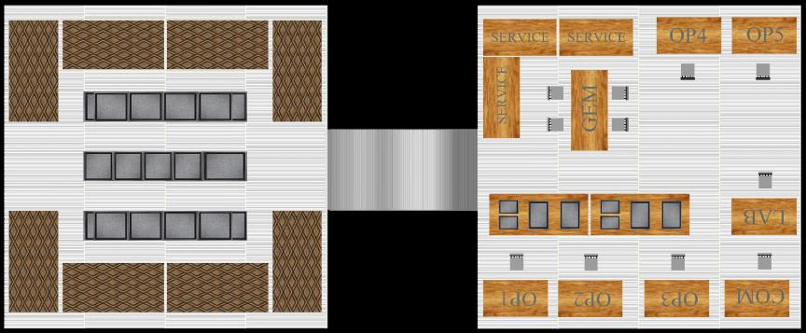
Dormitory
GEM
DORM
HALL
GEM
Notes:
Provisional floor plan for the Atlas Cove main facilities. The left tent is the dormitory, with room for 16 cots plus storage. At right is the GEM tent, containing tables for food preparation and eating, radio and laboratory work tables, and active storage. The passageway between the tents is covered, so the team members can move within the facility without going outside.

Slide 23
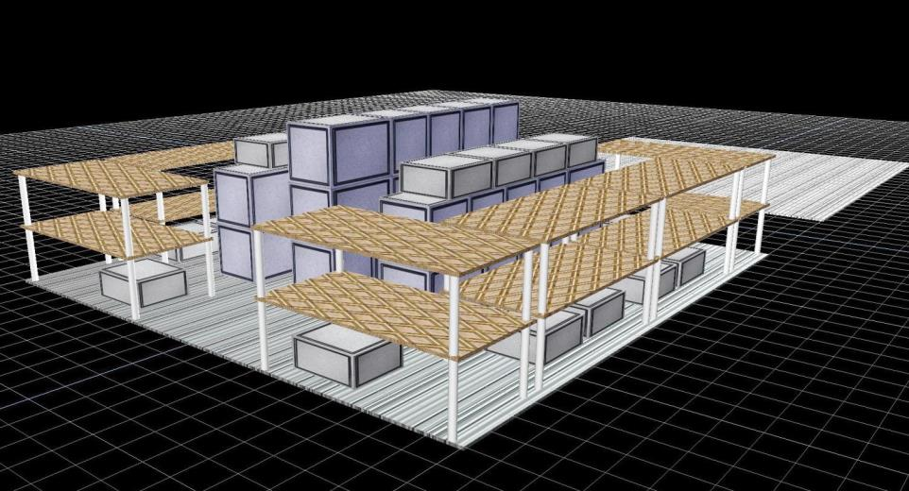
Dormitory, including storage
16-bed DORM/STORAGE
Notes:
Rendering of the dormitory tent. Eight bunk beds provide for 16 persons. The central storage provides some isolation of the bunks, and protection for containers and supplies not needed in the GEM tent.

Slide 24
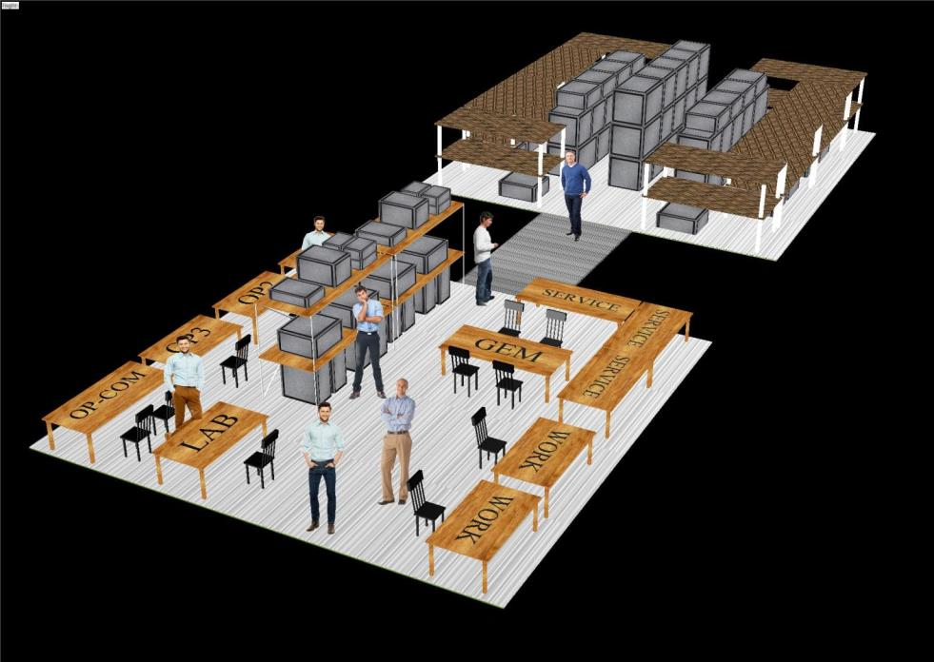
GEM
Greeting, Eating, Meeting
…and working
Notes:
Conceptual perspective rendering of the facility, from the GEM tent side.

Slide 25
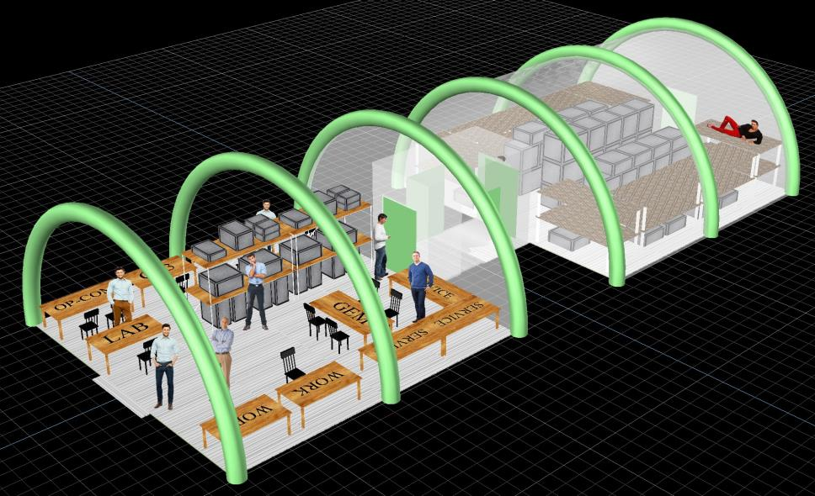
The main VKØEK campsite
Notes:
Showing the Airbeams that provide rigidity to the shelter. The beams are pressurized to 60 psi; each beam would hold up a small car. The shelters have inside canvas panels for insulation and moisture control.

Slide 26
GEM
HALL
DORM
Notes:
Side view of the Airbeam shelters.

Slide 27
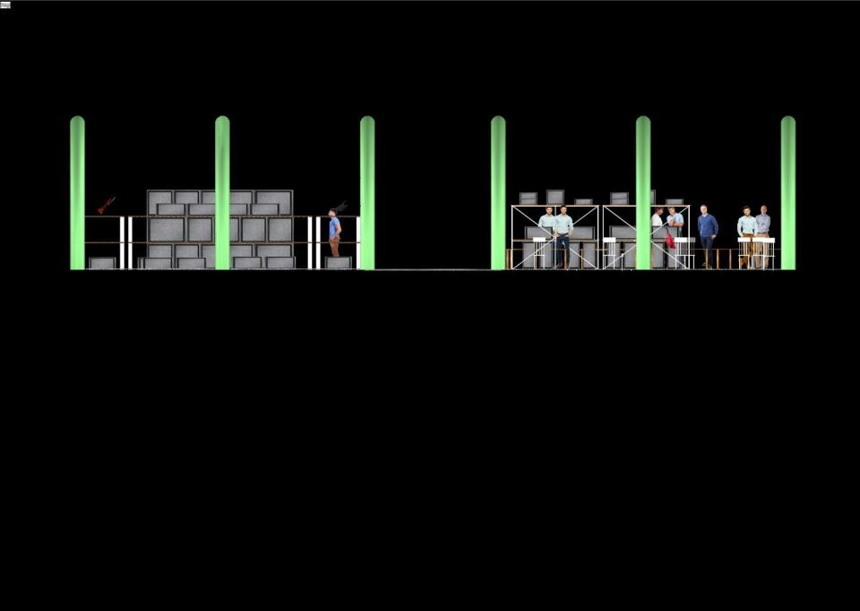
FRONT
Notes:
Side view of the shelters, with the covers removed. This is mage is purely artwork–in reality, the covers are an integral part of the shelters and are not removable.

Slide 28
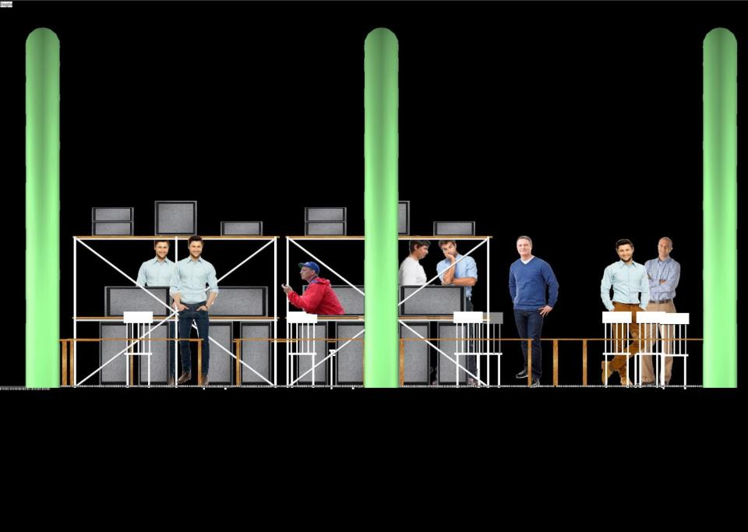
Notes:
Closer view of the furnishings in the GEM tent. The drawing is to scale, allowing realistic planning for the furniture, storage, and operating tables.

Slide 29
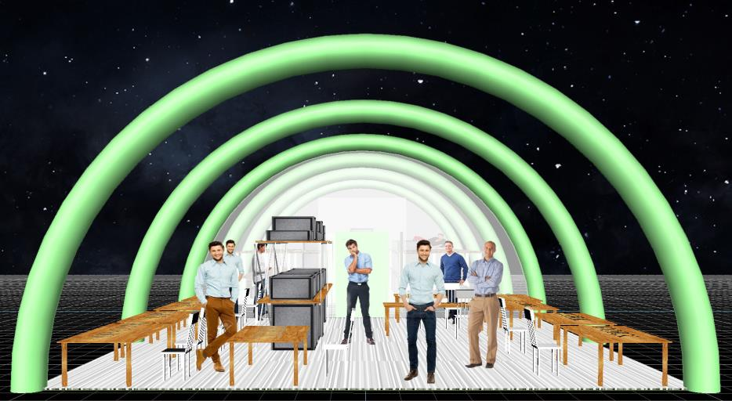
Notes:
Another view of the GEM tent: the main living, working, and research facility. The furniture arrangement is not final–it enables the design to establish the inventory and logistics of the equipment and supplies for the operation.

Slide 30
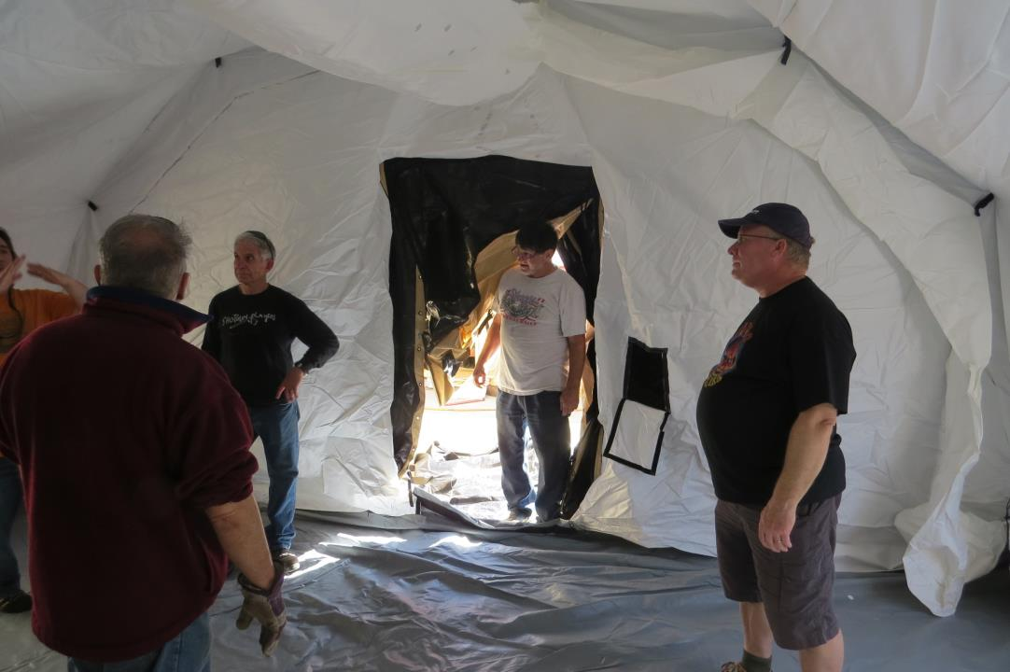
Notes:
Inside an Airbeam shelter. This one was procured by the VKØEK team to evaluate its appropriateness for use on Heard Island (it was deemed perfectly appropriate!).

Slide 31
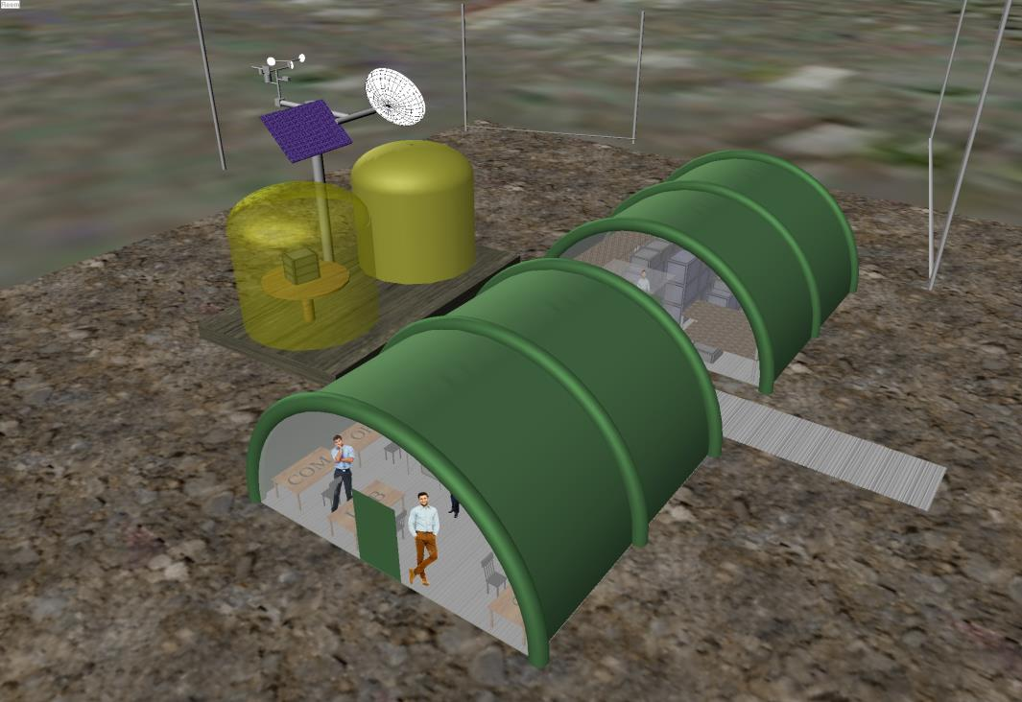
Notes:
Drone-view of the main camp at Atlas Cove. The gold shelters are permanent refuges. There is discussion about installing a remote automatic weather station (shown schematically).

Slide 32
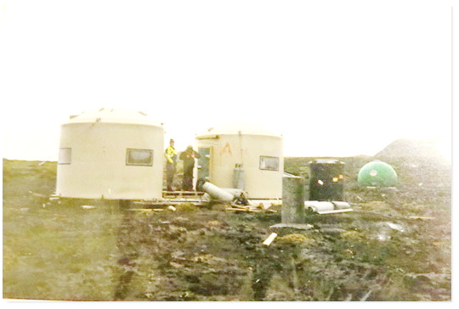
AAD TANK REFUGE SHELTERS 2003
Notes:
The actual refuge shelters at Atlas Cove. These were fabricated from water tanks 9 ft. in diameter.

Slide 33
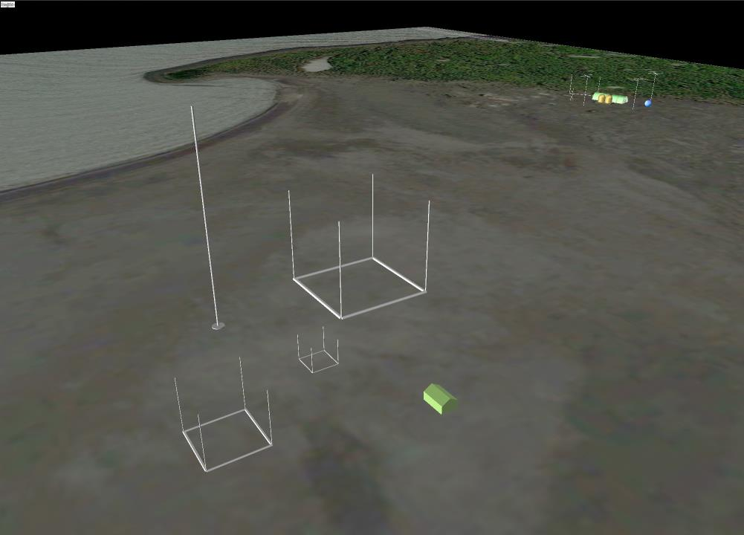
Notes:
Conceptual layout of the VKØEK stations at Atlas Cove. The two sites are connected by a high-power WiFi. The satellite connection is in the main site at rear.

Slide 34
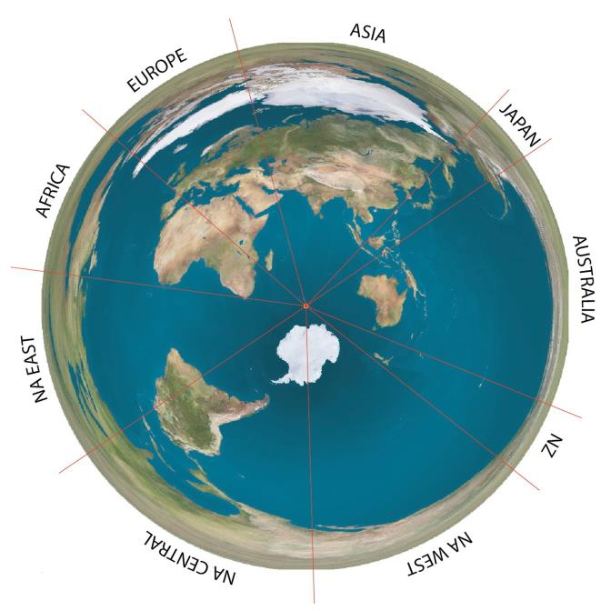
Notes:
The DX world around Heard Island. With the antipode near Saskatoon, Canada, North America is spread out over then entire azimuth, making it difficult to know precisely which path signals follow.

Slide 35
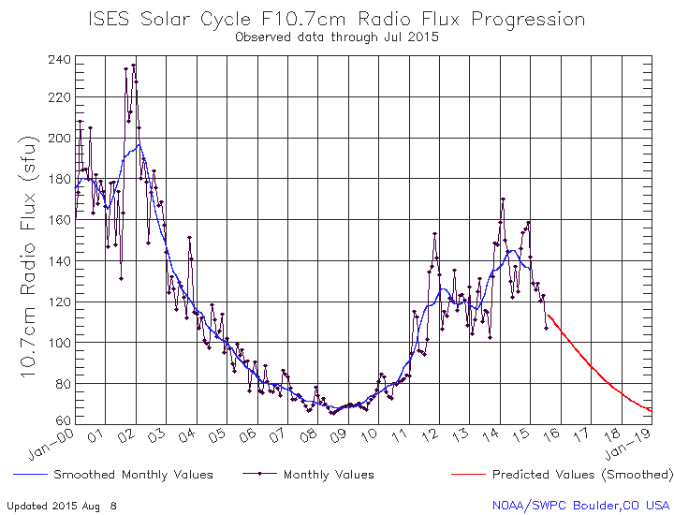
VKØEK
Notes:
Solar Cycle, showing the fall-off currently underway. When VKØEK is activated, there should still be reasonable propagation on the middle bands.

Slide 36
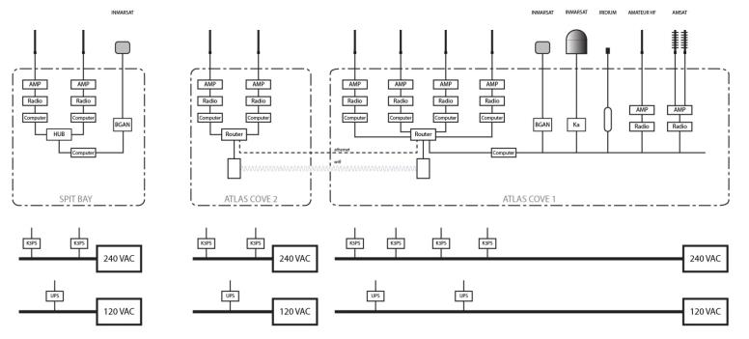
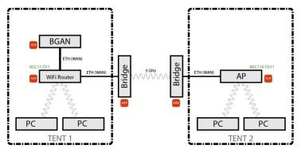
Basic wiring diagram for VKØEK
WiFi
Notes:
Wiring diagram for VKØEK. The emphasis in this diagram is on the dataflow, including the WiFi and satellite connections.

Slide 37
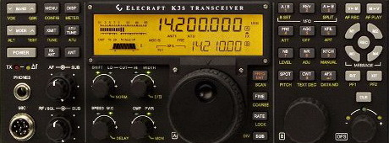
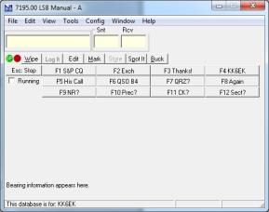
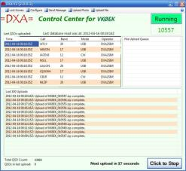
Stations
Elecraft K3S
N1MM+
DXA3
Notes:
The basic equipment to be used for all stations at VKØEK. Several amplifiers are under consideration.

Slide 38
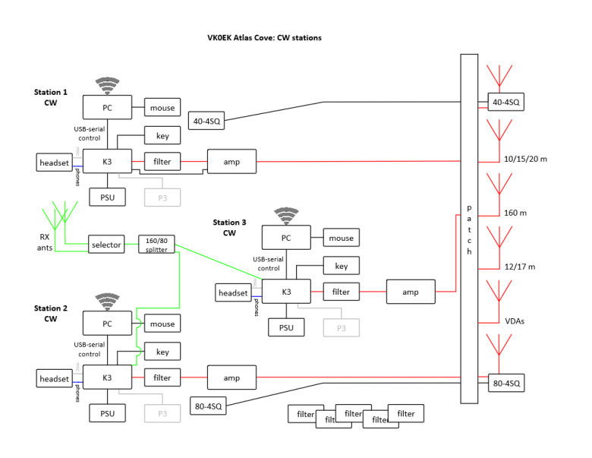
Heard Island - Atlas CW Stations
Notes:
Block diagram of the VKØEK stations. At Atlas Cove there are nominally 4 stations, with 2 backups. At Spit Bay there will be another 2 stations.

Slide 39
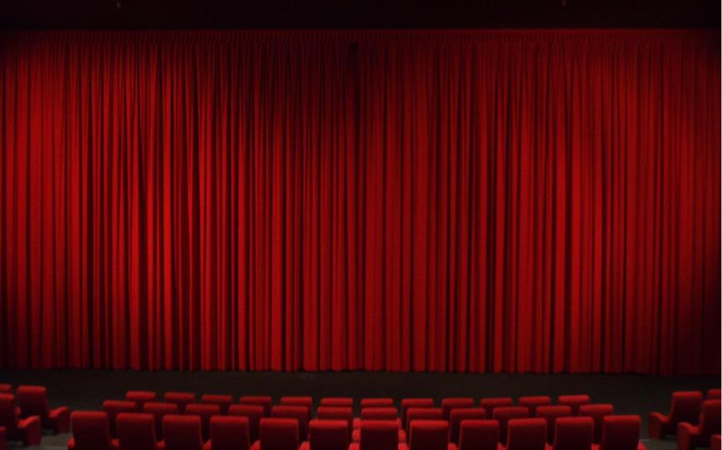
Antennas
Coming soon…
Notes:
The antennas to be used at VKØEK. The design is still undergoing optimization, hence will be shown later.

Slide 40
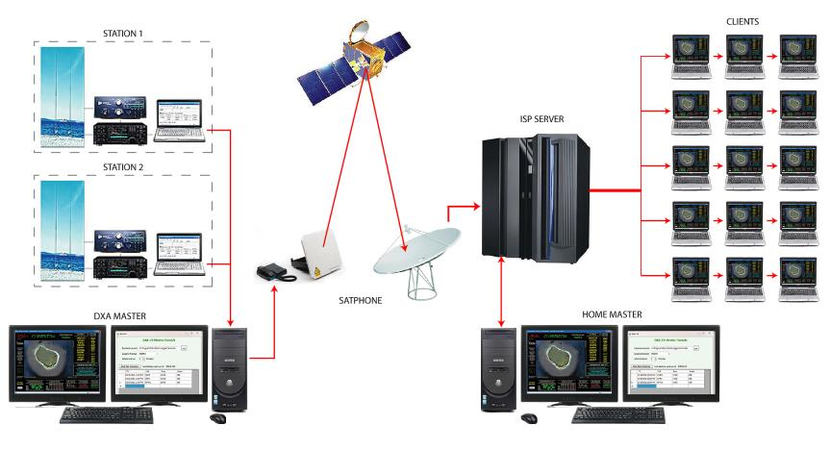
DXA - The Online Radio Log Server
Heard Island
Satellites
Internet
Notes:
The layout for DXA, the real-time online log server. The satellite most likely to be used is Inmarsat BGAN, although a new high-speed Ka mode has very recently become available that could enable real-time video.

Slide 41
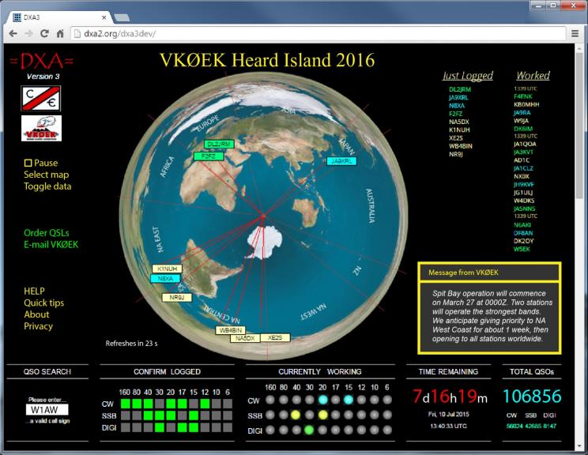
DXA - The Online Radio Log Server
http://www.dxa3.org
Notes:
The main DXA web page. The DXer should watch this page to get confirmation of his valid QSO within 1 minute of logging it. Confirmation will come on the map, the lists, and in the log-in “greenie” table lower left. If a QSO is not confirmed, he should try to make another QSO.

Slide 42
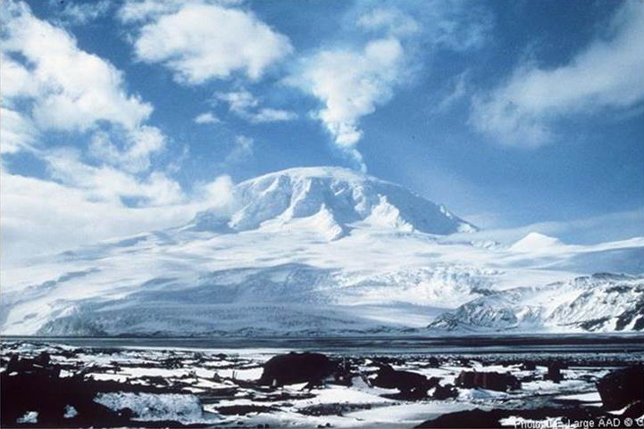
Notes:
From Atlas Cove, Big Ben presents a barrier to signals to and from North America, especially NA-West. Modeling with HFTA (High Frequency Terrain Analysis) has been used to optimize the antennas, and also to plan for a second operating location at Spit Bay.

Slide 43
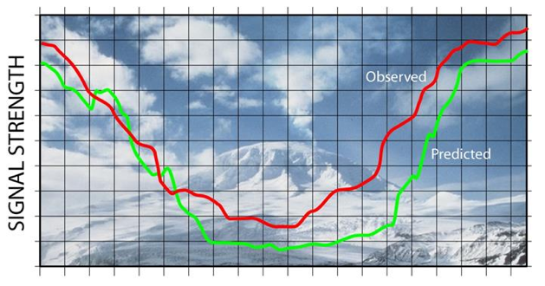
Heard Island - Geography
Notes:
The effect of the volcano is to attenuate radio signals, reducing the chance for DXers to make a confirmed QSO. Comparison of the observed QSO rates with HFTA predictions will provide a valuable test of the HFTA models and software.

Slide 44
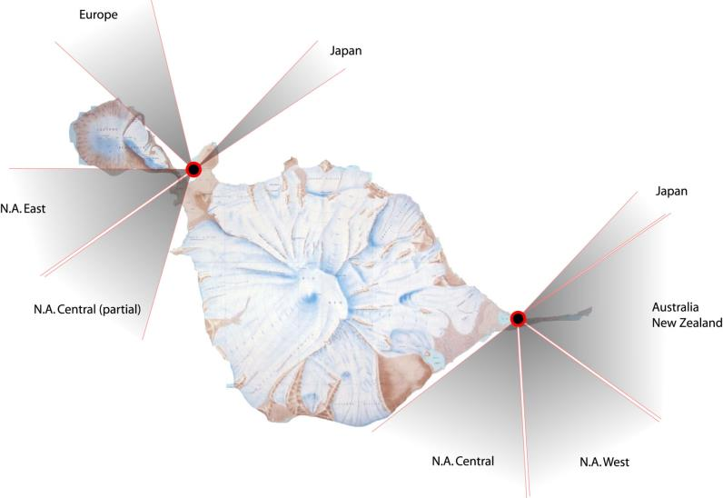
Radio paths to/from Heard Island
Notes:
The defense against the blocking effect of Big Ben is to establish a second radio operation at Spit Bay. Most parts of the world are visible from both locations, but North America Central and West will be significantly stronger from Spit Bay than from Atlas Cove.

Slide 45
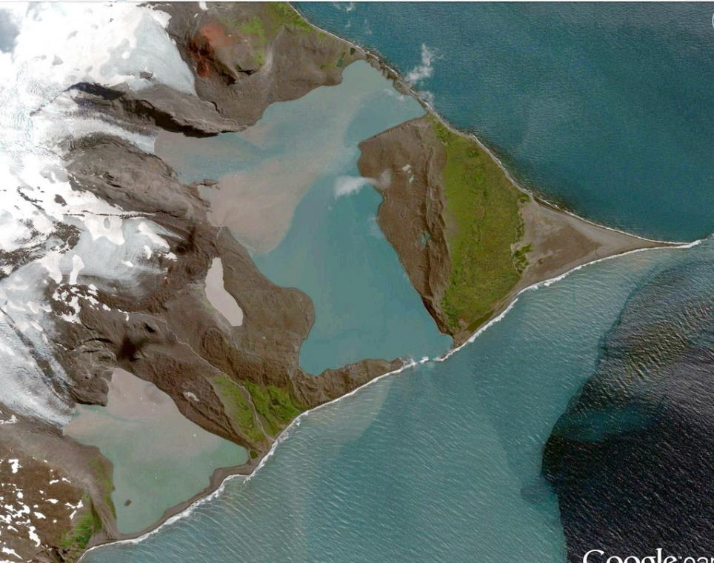
2014
Notes:
Spit Bay has be significantly altered since the last major DXpedition (1997), and more so in the past 10 years. The large lagoon in the center resulted from melting of the Stephenson Glacier (left), due to warming. The smaller, muddy, worm-shaped lake, called a tarn (left center) is of special interest for several reasons, primarily because of major geologically changes that have occurred recently.

Slide 46
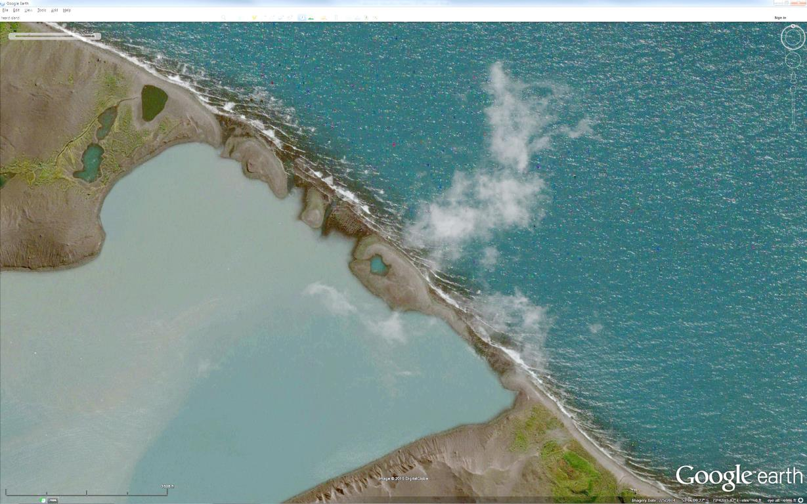
Notes:
Close-up of the northern entrance to the Stephenson Glacier-Lagoon. The barrier is about a mile across, and 300-1000 ft. wide. Probably it cannot be crossed on foot, due to the several open channels. At the extreme lower corner of the beach is a group of five permanent refuge shelters, installed by the Australian government. These will be used for the second VKØEK operating site.

Slide 47
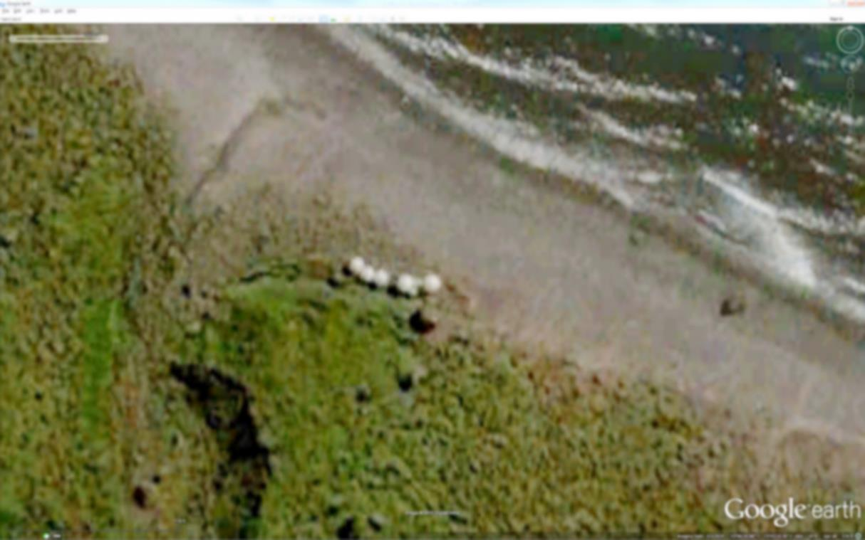
Notes:
Enlarged image of the refuge shelters at Spit Bay.

Slide 48
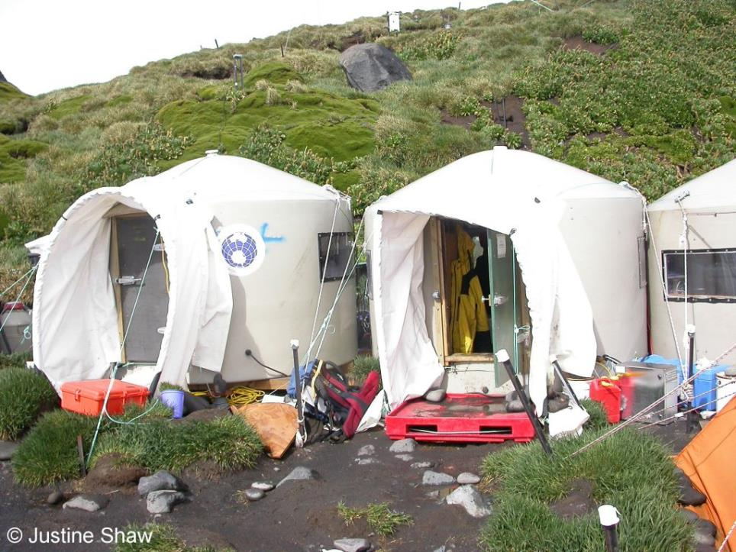
Notes:
The water-tank refuge shelters at Spit Bay. The antennas will be placed on the hillside to the rear.

Slide 49
Notes:
Beach view of the shelters at Spit Bay. Mawson Peak on Big Ben towers in the background.

Slide 50
Scientific research
Goal:
Obtain new observations and data relating to the effects of global climate change
Means:
Collections of specimens to identify unknown species of plants and animals
Photogrammetry to measure changes in glaciers, lagoons, and land, espeically recently deglaciated land
Photodocumentation of new geologic features such as emergent streams and plumes, eruption and venting, weather and atmospheric phenomena
Notes:
The scientific program is oriented toward obtaining new data of relevance to understanding and prediction of the effects of global climate change.

Slide 51
Notes:
The Stephenson glacier lagoon, newly filled within the past 10 years. The tarn at lower left-center apparently has a major plume inlet and an underground outlet. The latter clearly carries a huge sediment load into the lagoon.

Slide 52
Notes:
The Stephenson tarn. The left side is rather steep, with plants growing on the slopes, while the right side has a relatively shallow rise to contain the tarn.

Slide 53
Notes:
Comparison of the northern limit of the Stephenson tarn nin22007 with the same area in 2014. Clearly, a major landslide, about 300 ft. long along the eater edge, created a plume that sprays into the tarn more than 100 ft.

Slide 54
Notes:
Enhanced close-up of the Stephenson tarn plume, also showing the extent of the collapse. The outlet of the tarn apparently is underground away from the northern tip.

Slide 55
Notes:
An apparent underground stream carries sediment from the tarn into the lagoon. The width of the stream before it breaks into a delta near the edge of the lagoon is about 50 ft. The huge sediment load results from the drainage from the bottom of the glaciers into the tarn, and its rapid drainage out of the tarn by this underground stream.

Slide 56
Notes:
Streams emerging from underground on the south side of Big Ben. About a dozen such streams have been identified by the expedition team, and confirmation of their reality is a primary goal.

Slide 57
Notes:
Close-up of one of the emergent streams. Apparently the stream issues directly from a hole in the rock wall. We can estimate the flow of this stream as perhaps 1000 gallons/minute, or 1 million gallons per day. Over the course of the summer, it could drain perhaps 30 million gallons, about 0.001 of the total water production by all the glaciers in the State of Washington.

Slide 58
Aerial images using remote airborne cameras
Multicopter (drone)
Flyable (kite-borne) camera
Notes:
Aerial cameras to be used to obtain images of geologic features too inaccessible to be visited in person during the expedition.

Slide 59
Search for new species as particulates in water and air
Waterborne
Airborne
Wet-dry vac
“Next-Generation” Impactor
Anderson Impactor
Notes:
Various apparatus for collecting particulates from water and air.

Slide 60
Digital microscope to image microscopic organisms
Foraminifera
Tardigrada
Notes:
A digital microscope will enable documentation of tiny organisms while they are still fresh. Foraminifera are valuable indicators of past climate (by measuring their oxygen isotopes). Tardigrades have the special ability to suspend metabolism and remain dormant for long periods (more than 100 years).

Slide 61
Photo-documentation of environmental debris
Plastic
Bonal
Heard Island receives floating debris directly from South Georgia
Notes:
The debris burden in many parts of the ocean has increased by factors of 10 to 100 over the past decade. The impact on polar regions, including subAntarctic islands such as Heard Island, is unknown. Expedition member will explore various beaches and document debris, including both man-made and natural (bones, carcasses, etc.).

Slide 62
Roller vortices shed from mountains affects biota
Roller vortices
A remote automatic station could record wind data over a year
Notes:
Winds on Heard Island have a major influence on the biological communities. One less-common phenomenon is the creation of roller (horizontal axis) vortices on the lee side of a mountain, moving at high speed downslope and either out into the ocean or upslope on the other side of a valley or bay. A remotely accessible automatic weather station could gather data on this process even after the team has left Heard Island.

Slide 63
Search for the
reported
new Type of
killer whale
Pitman et al.
Notes:
Over the last decade, a new (fourth) Type of killer whale has been reliably signed and documented in an annular zone lying approximately in the Lat. -50 deg. Due to its rarity, there is incentive to search for and photograph this animal during the 20+ days the expedition will be sailing in its observed range.

Slide 64
Full Project Plan:
www.heardisland.org
/DOCUMENTS/
Notes:
A large amount of documentation is available about the expedition, much of it downloadable from the website.

Slide 65
Free download at www.heardisland.org
Notes:
The complete book VKØIR Heard Island about the 1997 DXpedition is available for free download from the expedition website.

Slide 66
Available from KK6EK
Notes:
The book DXA The Real-time Online Radio Log Server is available from the author KK6EK.

Slide 67
The Heard Island Newsletter
Free (electronic) subscription at:
www.heardisland.org /NEWSLETTER/
Notes:
The Expedition distributes an (electronic) newsletter, obtainable by subscription from www.heardisland.org /NEWSLETTER/

Slide 68
The 2016 Heard Island DXpedition the On-Island Team
Adam Brown K2ARB
Alan Cheshire VK6CQ
Arliss Thompson W7XU
Bill Mitchell AEØEE
Carlos Nascimento NP4IW
Dave Farnsworth WJ2O
David Lloyd K3EL
Fred Belton WM4MXD
Gavin Marshall VK2BAX
Hans-Peter Blattler HB9BXE
Jim Colletto N6TQ
Kenneth Karr NG2H
Robert W. Schmieder KK6EK
Vadym Ivliev UT6UD
Notes:
The on-site team for the 2016 Heard Island VKØEK expedition.

Slide 69
The W4DXCC Angel Match
Donations made at the W4DXCC Convention will be doubled by the
VKØEK Angel
Please see team member
Fred Belton KM4MXD
or
Dave Anderson K4SV
Notes:
Donations made in person at the W4DXCC radio convention will be matched dollar-for-dollar by the Angel.

Slide 70
Dr. Robert W Schmieder
KK6EK
Cordell Expeditions
4295 Walnut Blvd.
Walnut Creek, CA 94596
Phone:
(925) 934-3735
e-mail:
schmieder@cordell.org
Website:
http://www.cordell.org
www.heardisland.org
Notes:
Contact information for the 2016 Heard Island Exzpedition.

